Slide 1
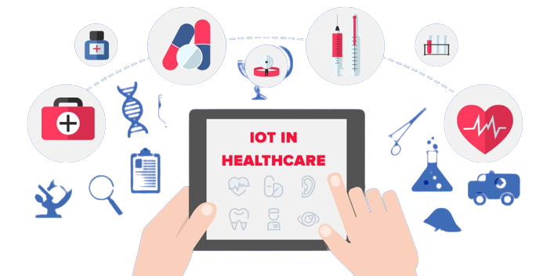
A Survey on Internet of Things (IoT) Based Healthcare Monitoring System.

Slide 2
International Journal of Advanced Trends in Computer Science and Engineering.
August 2019.
Department of Computer Science,
Maharshi Dayanand University,
Rohtak, India.

Slide 3
Introduction
Healthcare is a top priority in our culture, and the Internet of Things (IoT) is a field of study that is expanding rapidly and picking up everybody's attention due to its potential to transform the current healthcare system and develop solutions like the aging population and the steadily increasing rates of chronic illness that are infesting the healthcare system. In contrast to the traditional healthcare system that was historically utilized to deliver healthcare services, the IoT is now being implemented into the healthcare system to update patient care. This study describes how (IoT) has altered the conventional healthcare monitoring strategy and improved service speed and efficiency.

Slide 4
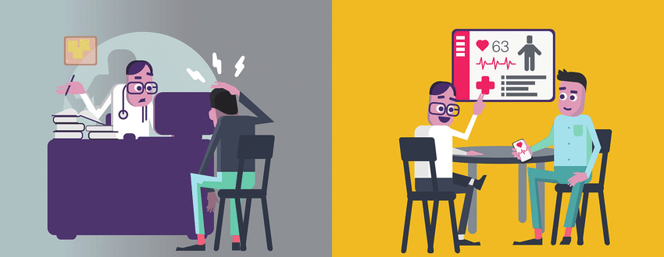
Traditional vs Digital Health based medical practices

Slide 5
Difference between traditional and modern Health care system
--------- | Traditional Healthcare | Modern Healthcare
Center of care | Center of care is the clinic or lab | Center of care is the patient
Based on | Based on populations | Based on individual
Focusing | Focus on disease treatment and prevention | Focus on personalized health management
Cost | Expensive | Less expensive
Time | Limited time | Any time
Place | Acute hospitals | Anywhere
Target audience | Interested parties | Anybody
Data | Data owned by the institution | Data owned and shared by patients

Slide 6
New Technologies Of IoT
Identification Technology
Sensing Technology
Communication
Location Technology

Slide 7
Major Components Of The Smart Healthcare System
Sensor Technology
Smart Hospital
Big-Data Analysis
Cloud Computing
Intelligent Network
IoT
Healthcare

Slide 8
Comparison of different IoT-based healthcare systems
Author Name | Problem Addressed | Aim | Methodology | Merits | Demerits
Boyi Xu et al. “A” | Heterogeneity of data format generated from different sensors in IoT platform | Design a model which solves the heterogeneity problem | Unified data model and semantic data model, use ontology techniques | Highly significant in decision making | Not appropriate for long supply chain
Pankaj Deep Kaur & Inderveer Chana . “B” | Real-time monitoring of patients suffering from chronic illness | Design a "Cloud” Based Intelligent Healthcare Service that performs real-time monitoring of patient's health data | Advanced body sensor components, cloud-based repository and a mechanism that supports dynamic resource elasticity, KNN and Naïve Bayes classification techniques | 1- Cost effective and globally accessible 2- supports better classification accuracy 3-dynamic infrastructure elasticity | Accuracy is 92.59% for KNN and 85.71 % for NB only
Prabal Verma, Sandeep K. Sood. “C” | Diseases mainly faced by students | To design the diagnosis of a diseases healthcare framework and generate alarm depending on disease severity | Health data acquired from medical sensors, gateway used, and alarm generation mechanism is also used to make alerts in an emergency situation, SVM, KNN, DT, NB | Diagnosis process more effective and reliable | Less versatile, DT-92.8%, SVM-87.4%, KNN-92.3% accuracy

Slide 9
Ontology technique helps in representing the knowledge about the environment, events, and actions that help in path planning and making robots more autonomous.
Ontology Technique

Slide 10
Comparison of different IoT-based healthcare systems
Author Name | Problem Addressed | Aim | Methodology | Merits | Demerits
Joon-soo Jeong Et Al. “D” | Traditional Healthcare System | introduce IoT healthcare to improve patient monitoring and early diagnosis of diseases. | IoT healthcare implementation methods such as data collection, intelligent network, cloud computing, & data Analysis | Offer Early Disease Diagnosis And Better Health Monitoring | Null
Prosanta Gope, Tzonelih, Hwang. “E” | Aged people suffering from chronic diseases unable to take care of themselves | To design A network that can offer better services to people at a high security | Low power and light weight wireless sensors are used to monitor the human body and the surrounding, AES-CBC and CBC-MAC encryption techniques are used for security | Highly Secure | Expensive

Slide 11
Conclusion
& Future Work
The incorporation of IoT concepts into the healthcare sector significantly altered the way patients were treated. We describe how the IoT has transformed the healthcare sector by providing patients with extremely rapid and dependable services. According to the findings of several studies, the usage of sensor-based medical gadgets in the healthcare environment is steadily expanding, making the patient treatment process more trustworthy and efficient. The new IoT idea may alleviate the burden of frequent medical visits for patients. Patients may obtain all of their health information on their phones and call physicians in an emergency. Doctors can even offer medications to patients over the phone from anywhere.
According to the analysis of research work done by various researchers, there are still some major issues with the modern healthcare system such as system precision, security and protection of valuable data, and poor data analysis techniques that must be resolved in the near future to promote better healthcare service.

Slide 12
Thank You.
Shahad Altamimi.

